Slide 1

Analysis of British Airways Booking Records
We evaluate model performance and feature significance to understand the most impactful variables driving customer bookings. These insights will support data-driven strategies for optimizing service offerings, enhancing customer satisfaction, and refining marketing efforts.

Slide 2
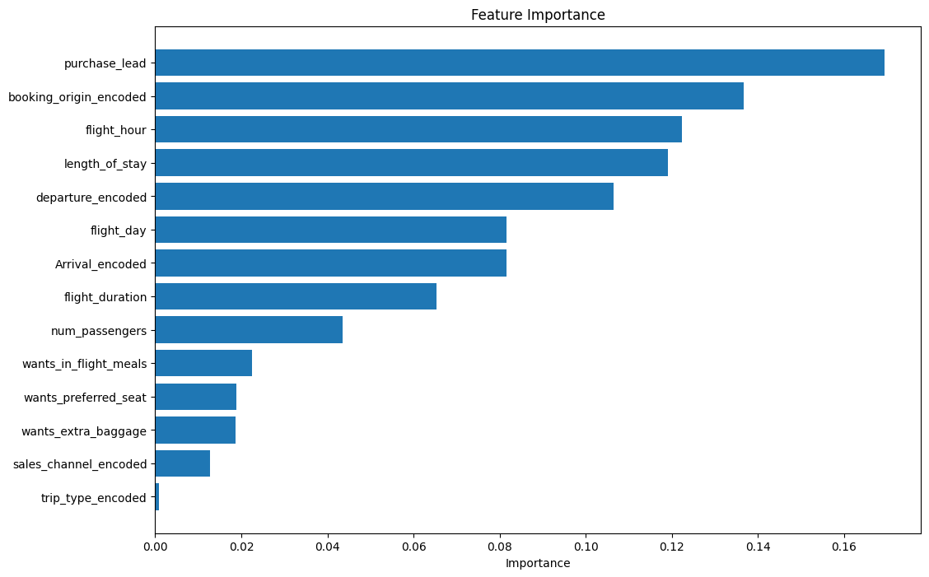
Best Model: Random Forest
Best Parameters :
max_depth: 20
Max features: 'sqrt’
Min samples leaf: 2
Min samples split: 2
N estimators: 300
Best Cross-Validation Accuracy:
0.851657142857143
Test Accuracy:
0.8531333333333333

